Slide 1
CS143 Discussion Session
Week10
Mingda Li

Slide 2
Today’s Topic
Sample Final Exam

Slide 3
E/R model review
rectangle: entity (e.g. student)
oval (ellipses): attribute (e.g. name)
diamond: relationship
lines: connect attributes/entities and ntities/relationships
double line: total participation
An entity participates in the relationship AT LEAST ONCE.
double rectangle: weak entity set (e.g. HomeworkSubmission(hw#, grade) - requires key from another entity in relationship to identify, from “owner” entity set)
student
name
attend
homework

Slide 4
E/R model review
ISA
triangle: ISA relationships specialization and generalization ⟨eg: Student, ForeignStudent, DomesticStudent⟩
Weak entity set
An entity set that does not have a primary key is referred to as a weak entity set.
The existence of a weak entity set depends on the existence of an identifying entity set.
It must relate to the identifying entity set via a total, one-to-many relationship set from the identifying to the weak entity set.
Identifying relationship depicted using a double diamond.
The discriminator (or partial key) of a weak entity set is the set of attributes that distinguishes among all the entities of a weak entity set.

Slide 5
E/R model review
ISA
cardinalities: one to one, one to many, many to one, many to many
  undirected: many-to-many
  arrow: points to the “one” side
  [employee]----<affiliate>--->[manager] ?
    customer to loan is one-to-many? many-to-one?
  a..b notation: says how many participate in the relationship
  [employee]--0..*--<affiliate>--0..1--[manager] ?
  [employee]--0..1--<affiliate>--0..*--[manager] ?
  [employee]<---<affiliate>--->[manager] ?
    one to one from customer to loan

Slide 6
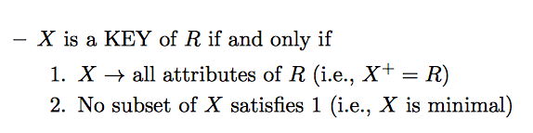
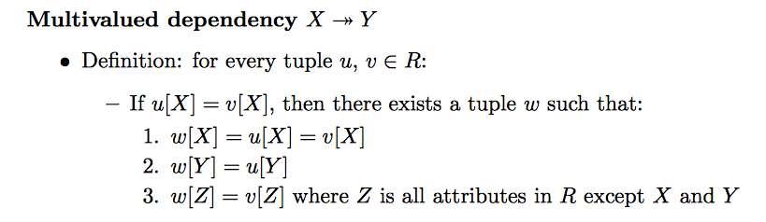
Understand BCNF and 4NF
Key:
Multivalued dependency

Slide 7
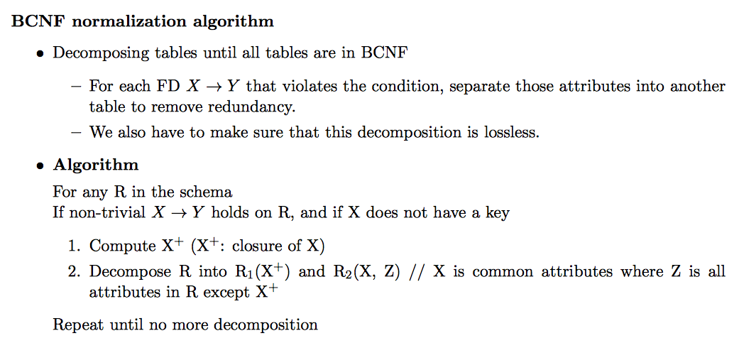
Understand BCNF and 4NF
BCNF
  R is in BCNF with regard to F, if and only if for every non-trivial X → Y , X contains a key
  Decompose such table.
4NF

Slide 8
Prob 3
Suppose we want to build a database on a mother, her children and the cars that the mother owns.
R(mother-name, addr, child-name, birth-date, vin)
Here, mother-name is the mother’s name, addr is the address of the mother, child-name is the name of her child, birth-date is the birth date of the child, vin is the vehicle identification number of the mother’s car.
There are following assumptions for this database:
A person’s name is unique.
A person has only one associated address.
A person has only one birth date.
A mother may have more than one child.
A mother may own more than one car.
A child has only one mother.
A car’s vehicle identification number is unique.
A car is owned by only one person.
A car is not associated with a particular child. Any children may use any car that their mother owns.

Slide 9
Prob 3
1. Find functional dependencies and one multivalued dependency given the above constraints and the schema. You do not need to list all functional dependencies. It is enough to list the set of functional dependencies that imply all functional dependencies satisfied by the relation. Also, the MVD that you list should not be implied by a functional dependency.

Slide 10

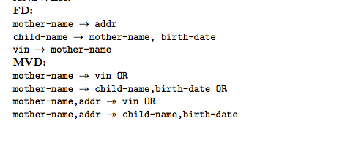
Prob 3
2.
R(mother-name, addr, child-name, birth-date, vin)

Slide 11
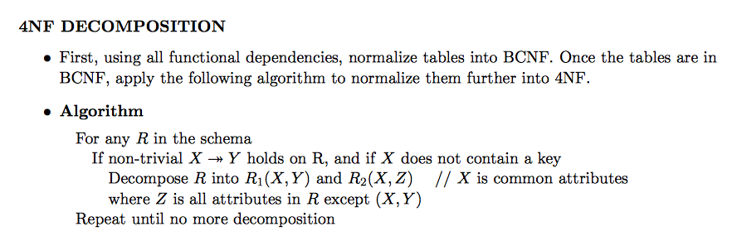
FOURTH NORMAL FORM (4NF)
Definition: R is in 4NF if for every nontrivial FD X → Y or MVD X Y , X contains a key
4NF removes redundancy from MVD
– 4NF: no redundancy from MVD and FD.
– BCNF: no redundancy from FD.

Slide 12
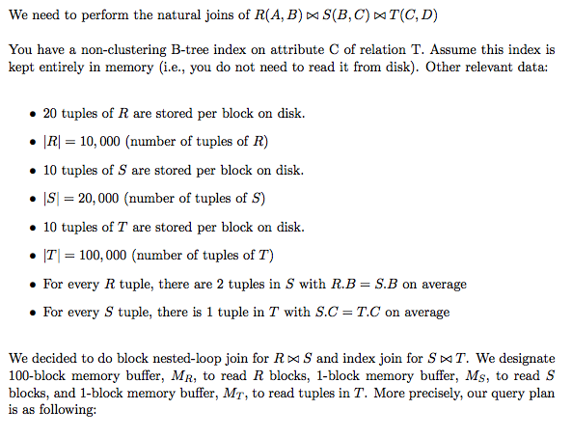
Problem 4

Slide 13
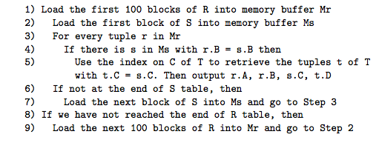
How many disk blocks does R table use?
How many times is each block of R table read during join? In total, how many disk block READs are performed on R table? How many for S?
How many times is each block of S table read during join? In total, how many disk block READs are performed on S table?
What is the expected number of output tuples from the join R ◃▹ S ◃▹ T? In total, how many disk block READs are performed on T table?
What is the total number of expected disk block READs for the entire join?

Slide 14
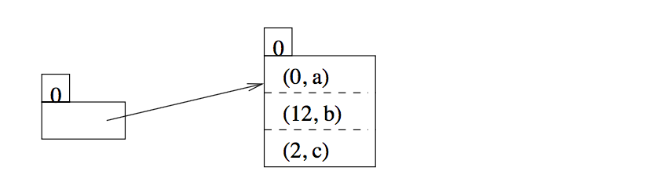
Problem 5
Consider a simple extendible hash index below. Assume that we use the hash function h(k) = (k mod 16) that produces 4 bit hash values. For example, h(20) = (20 mod 16) = 4, which is 0100 in binary representation. Each hash bucket has room for 3 records. The record (0,a) means that 0 is the search key and a is the remaining attributes of the record. Consider the following extendible hash index with i = 0.
1. Suppose that we insert two records (3,e), (4,f) into this hash index in the given order. Draw the index after each insertion.

Slide 15
2. For a B+tree index, if the same set of records are inserted in different orders, the final B+tree structure may be different. Is it also true for an extendible hash index? If true, give two record insertion sequences of the same set of records, which result in different final index structure. If false, explain your answer briefly. (Assume that the tuples in a hash bucket are always sorted by their key order and there is no hash collision.)

Slide 16
14 Test
1. When all SQL transactions run at the isolation level SERIALIZABLE, the database system guarantees ACID properties. Briefly explain what ACID means?

Slide 17
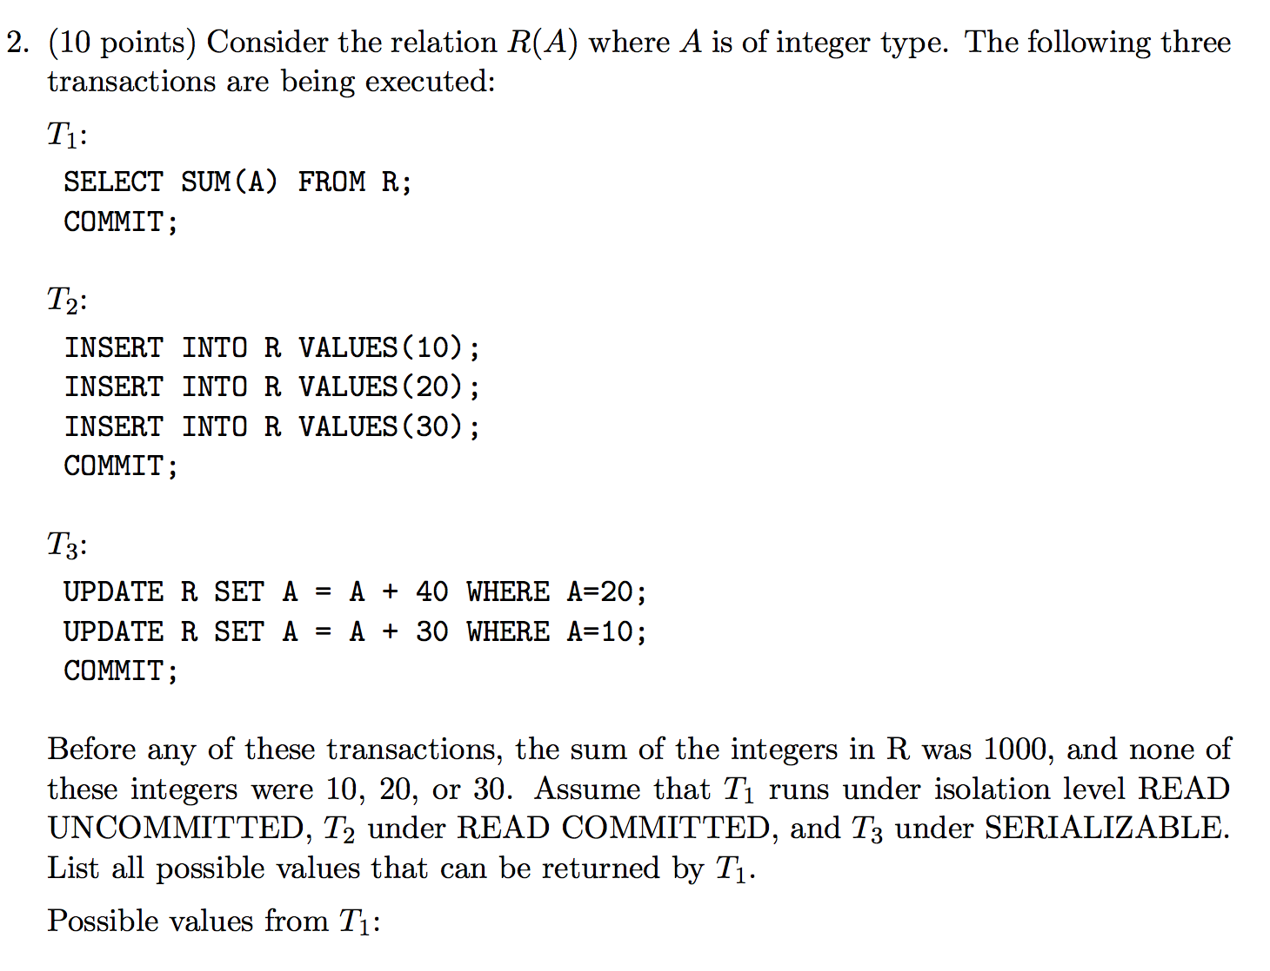


Slide 18
Good Luck!

